Slide 1




Chapter 6:
Harnessing Blockchain to Solve the Problem of Data Storage
Beginners Guide to Filecoin
Content created by Brown Zhang
Researcher @ KEN Labs

Slide 2
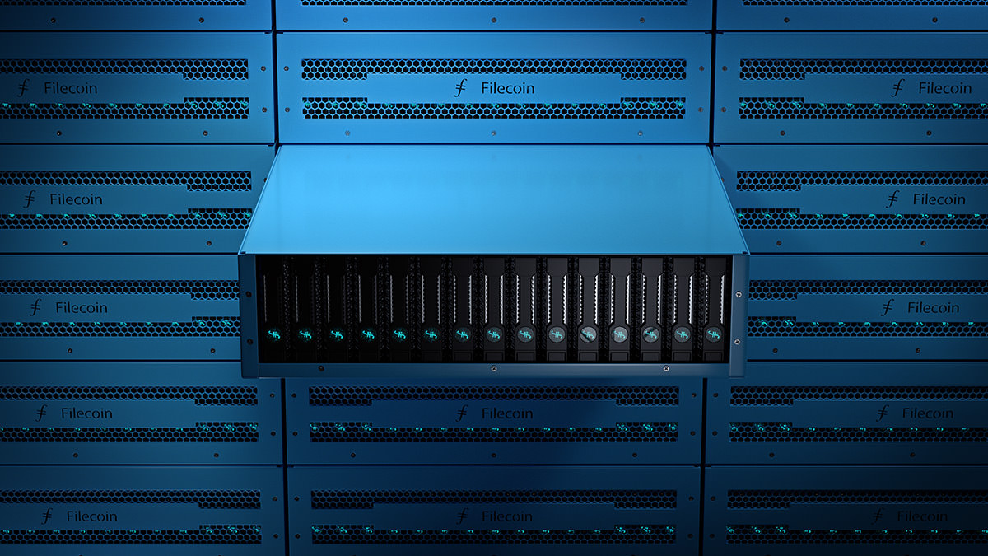
Storage is defined as the retention of retrievable data.

Slide 3
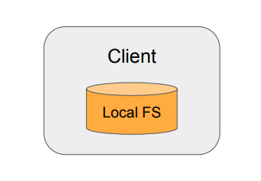
Local Storage
Trivial case: Client writes to local file system
Single point of failure
Bottleneck when other clients request data
Client is responsible for security

Slide 4
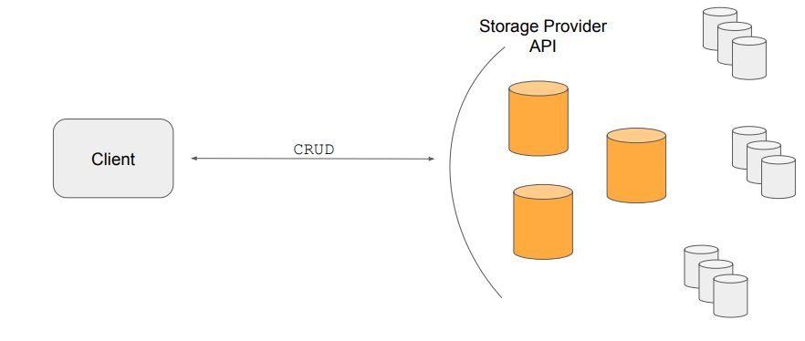
Centralized Storage

Slide 5
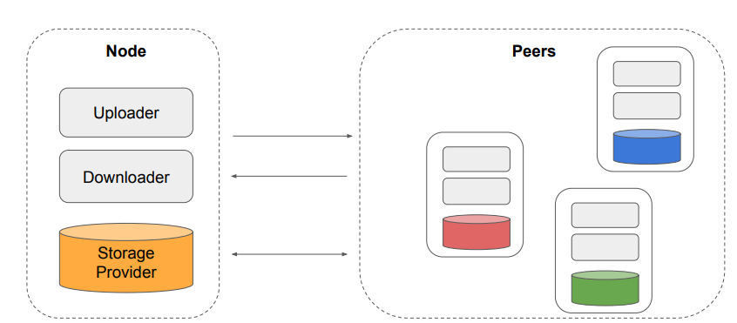
Decentralized Storage

Slide 6
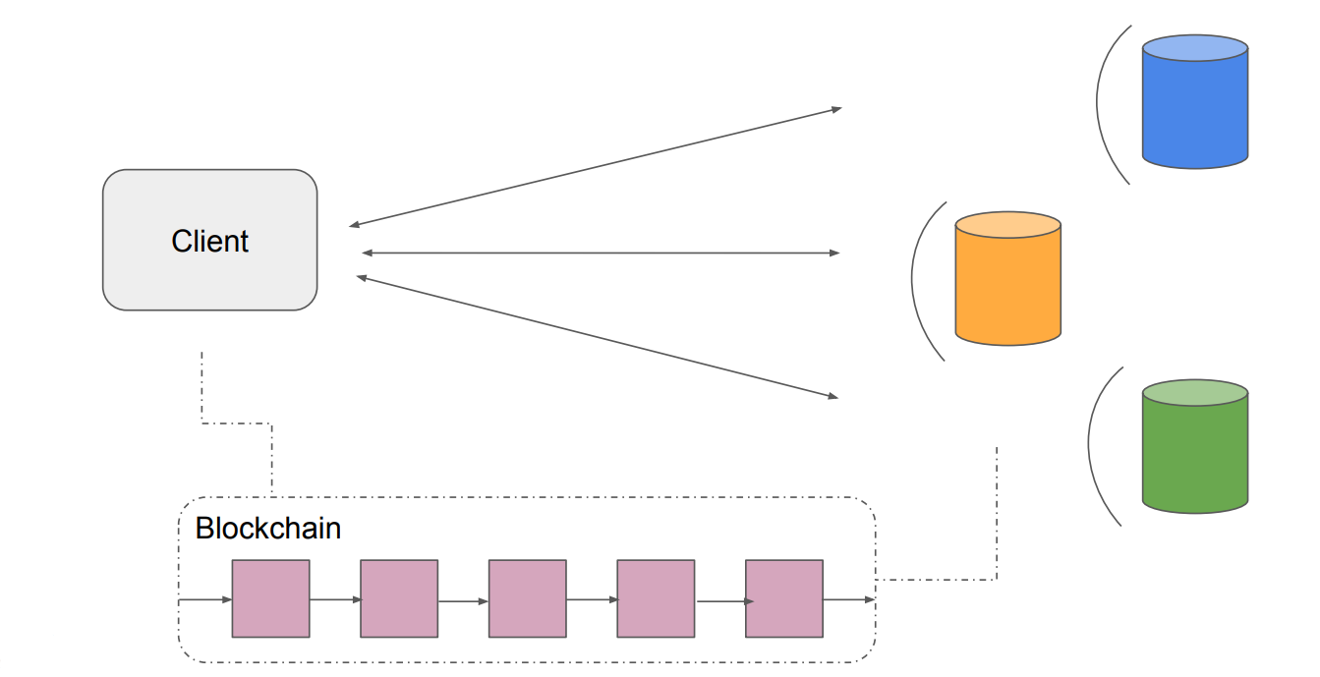
Incentivized Decentralized Storage
There are two different goals when designing such an incentive system:
Decentralized File Storage Service for End-Users
Provide contracts between client and storage provider
And provide payment for certain storage time intervals and SLAs
Permanent File Archive
Provides protocol to ensure that no file is ever forgotten

Slide 7
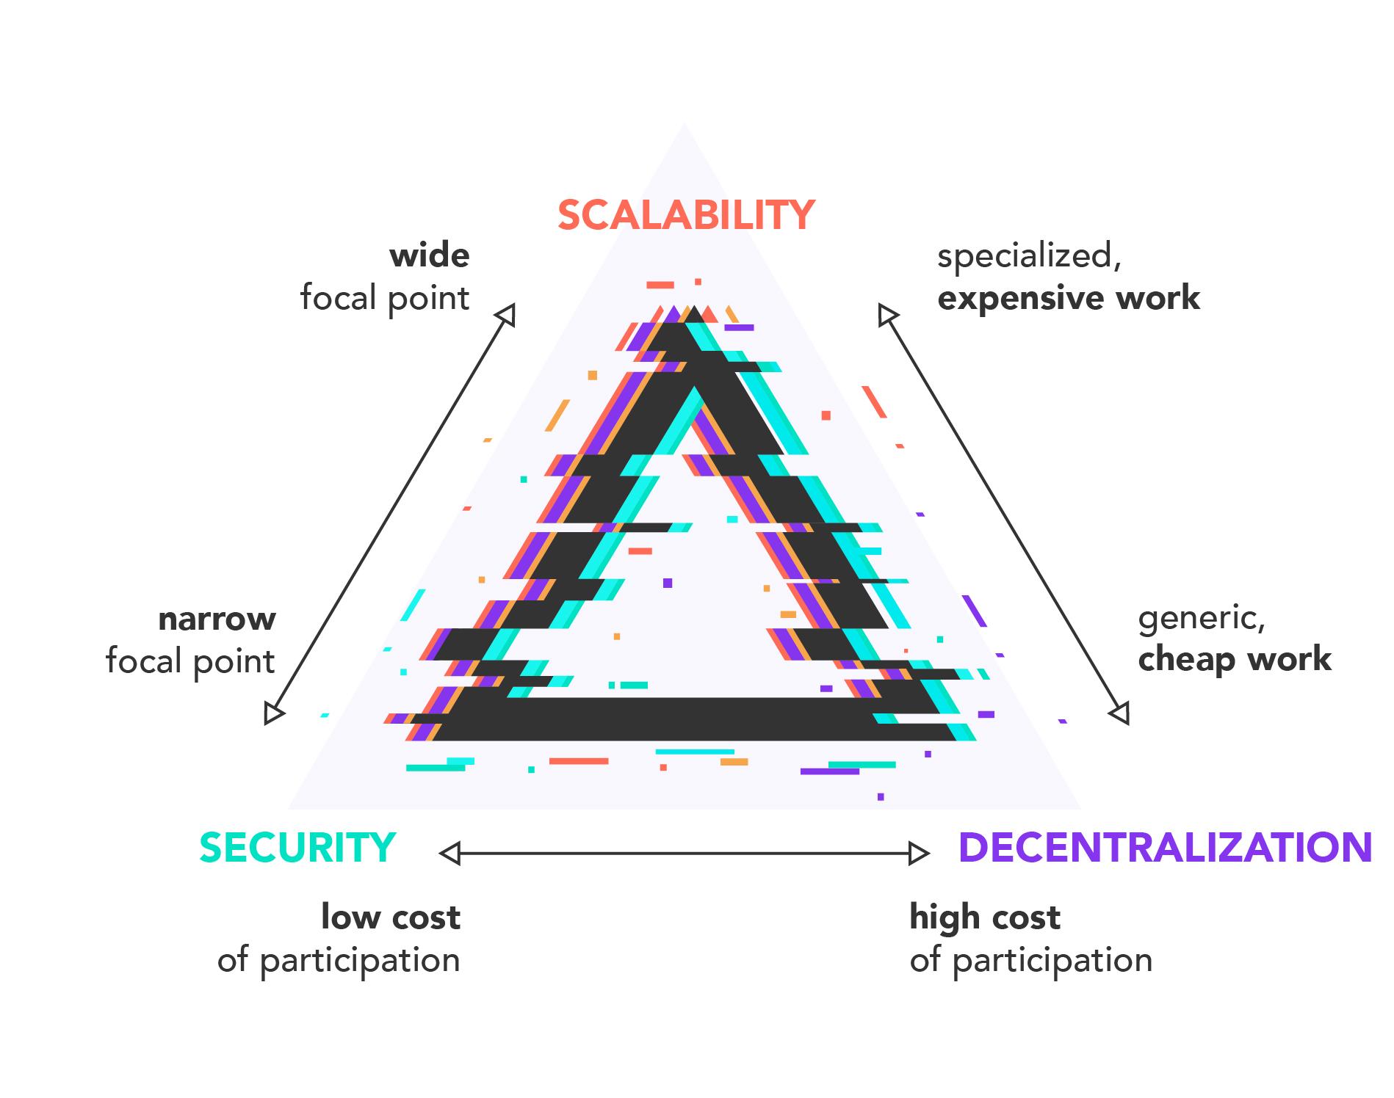
DCS triangle
However, blockchains, the record-keeping technology behind Bitcoin and other cryptocurrencies and tokens, face their own challenges. That's DCS triangles.
The DCS triangle, as the picture shown on the right, describes the top tradeoffs that decentralized systems must consider, which are Decentralization, Consensus, and Scalability.
The DCS theorem states that a decentralized system cannot have all three properties simultaneously.

Slide 8
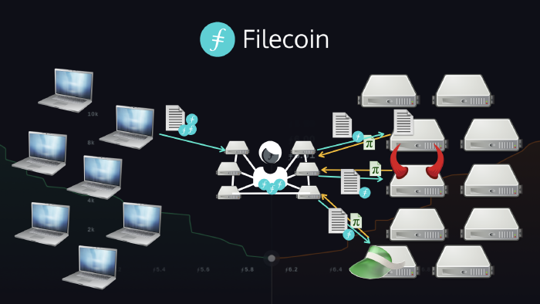
Decentralization of Storage
In 2015, Protocol Labs launched IPFS, a technology that decentralizes the web by addressing information based on what it is, not where it is. Addressing using a cryptographic hash of the content makes the data unalterable, can identify duplicates across the network, and enables any host to store and provide the data. This makes decentralization more efficient.
Filecoin shares many common components with IPFS including content addressing. Developers can integrate with these modular components to build in encryption and redundancy.

Slide 9
Consensus Across Many Actors
Filecoin incentivizes consensus about the state of what has been uniquely stored in the world, including a market for this, in a way that anyone can verify.
At its core are two Proofs-of-Storage that provide a more useful alternative to Bitcoin’s Proof-of-Work: PoRep and PoSt, which we've mentioned in the Previous video Beginners Guide to Filecoin Chapter 5.
With these proofs, the Filecoin protocol creates a trustless market for storage resources, amassing them into a self-healing, robust storage network on which anyone in the world can rely and join.

Slide 10
Scalability of the Protocol
Since protocol security and solid proofs constructions have been paramount, Filecoin laid out higher hardware requirements for block mining and storage mining.
Any part of protocol where a new market may arise opens up opportunities for community participants to leverage what they can do best: block mining, storage mining, retrieval mining, repair mining, as well as potentially offloading computation and other services.
With a strong foundation for trustless coordination in its protocol, Filecoin participants can achieve consensus around the decentralization of storage and use these evolving specialized markets to achieve future scalability.

Slide 11
Conclusion
Filecoin, developed by Protocol Labs, is a blockchain-based system to democratize file storage.
Protocol Labs is grappling with technical barriers and maintaining consensus while building a scalable decentralized storage solution.

Slide 12

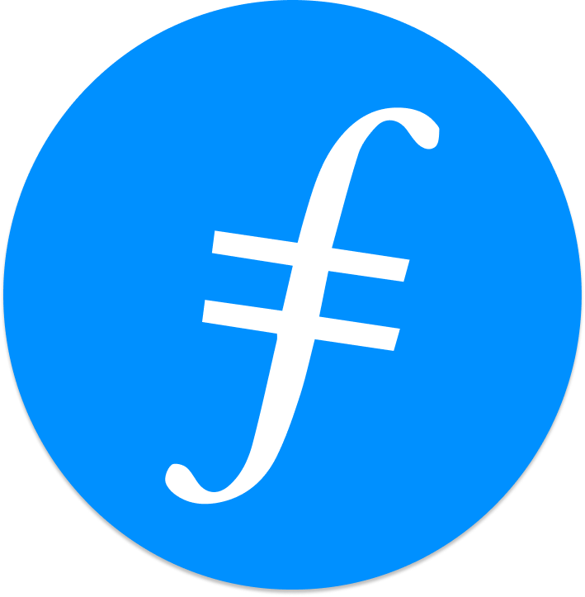
Feedback is welcomed.
https://github.com/kenlabs/Beginners-Guide-to-Filecoin

